Slide 1

E-Commerce Call Center & Sales Performance Dashboard Prepared by: Hasnaa Ahmed – Data Analyst Tools: Power BI | Excel |

Slide 2
Project Goal: Analyze and improve call center performance and sales operations.
Objective: To enhance customer service, product sales, and operational efficiency through data insights.
Scope: Analysis of customer orders, call center agent activity, and product behavior.
Outcome: Actionable insights to boost approval rates, track agent efficiency, and refine product targeting.

Slide 3
Data Snapshot
📈 Total Orders: 1,369
👥 Total Customers: 471
🌍 Cities Covered: 78
📦 Orders Under Review: 705
❌ Rejected Orders: 270
💰 Avg. Product Price: 167 EGP
🏬 Top Store: Ibn Al-Bitar 1
🛒 Best-Selling Product: BeeFirm
🚫 Most Rejected Product: BeeFirm Marhaba

Slide 4

Real Dashboard Views
Power BI Snapshots:
Sales Overview
Product Performance
Agent KPIs
City-Based Trends
Time/Hourly Breakdown

Slide 5
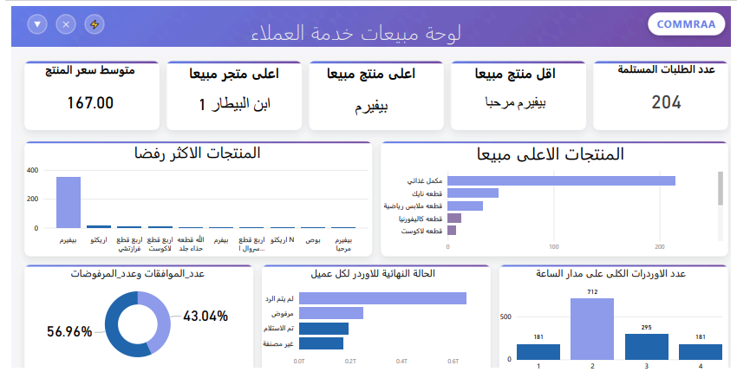

Slide 6
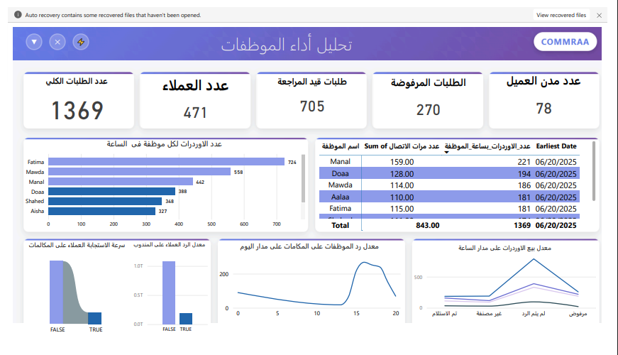

Slide 7
🔹 Key Dashboard Views
Sales Insights – Best/worst selling products, approval rates
City-Based Analysis – Regional order patterns
Agent Performance – Contact attempts, approvals per hour
Time Trends – Hourly response insights

Slide 8

Product, City & Agent Insights
🌍 Product Behavior by Region
📊 Rejection Rates by Product
⌚ Hourly Call Trends
💼 Agent Performance Metrics

Slide 9
🔹 Business Questions Answered
What are the top and worst-selling products?
Which cities have the highest order approval rates?
Who are the top-performing call agents?
When are orders most likely to be approved?

Slide 10

6 Data-Driven Recommendations to Improve Call Center Efficiency
Improve Data Quality – Validate cities, log all contact attempts, standardize status fields
Enhance Analysis Columns – Add response time, attempts, rejection reasons
Boost Agent Development – Identify and train underperformers
Optimize Contact Hours – Use hourly data to focus high-approval time slots
Visualize Product-City Trends – Stack charts for smarter stocking
Standardize Status Mapping – Unified labels for consistent tracking

Slide 11
🔹 Status Classification Map
Raw Status | Final Label
استلم / رد ويستلم | ✅ Approved
رفض الاستلام / مغلق / مش طالب | ❌ Rejected
لم يرد | 📞 No Answer
أجل الاستلام | ⏳ Delayed
Other | Uncategorized

Slide 12

🔹 Challenges & Solutions
Unclassified Cities → Enforce dropdowns or validation
Missing Contact Attempts → Retain full communication logs
Overloaded Dashboard → Separate views per topic (sales, status, agents)

Slide 13

🔹 Final Insights
High rejection for some products needs marketing re-evaluation
Peak performance hours identified – can boost shift planning
Better-trained agents = higher approval success

Slide 14
🔹 Slide 10: Thank You + Q&A
Let’s turn data into action. ✅ GitHub: View Full Repo

Slide 15

About Me
Hasnaa Ahmed Data Analyst | Specializing in Business Insight Generation LinkedIn:https://www.linkedin.com/in/hasnaa-ahmed-5a648a310/ - GitHub: github.com/evehasnaa

